Slide 1
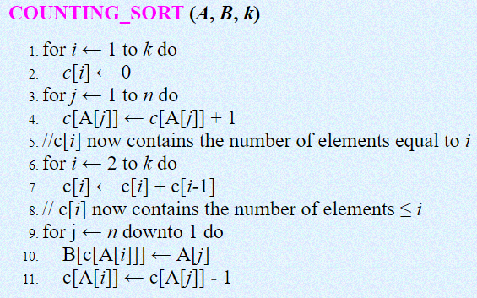
COUNTING SORT

Slide 2



COUNTING SORT

Slide 3


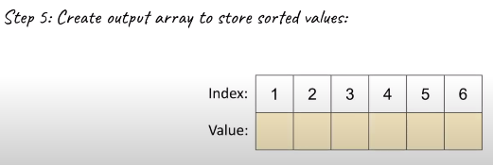
COUNTING SORT

Slide 4
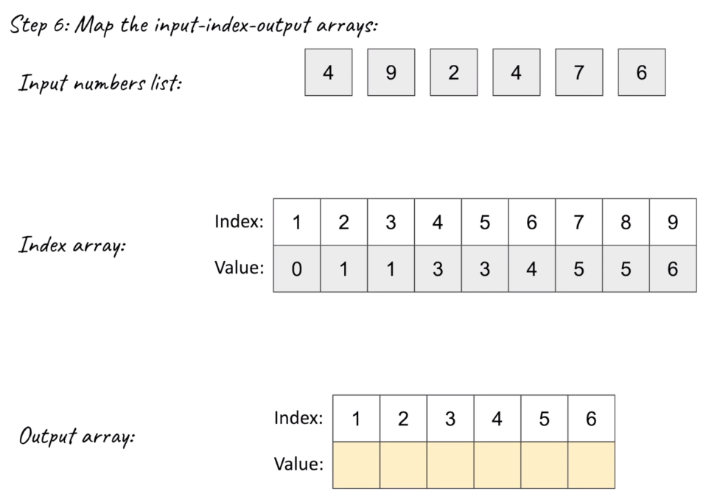
COUNTING SORT

Slide 5
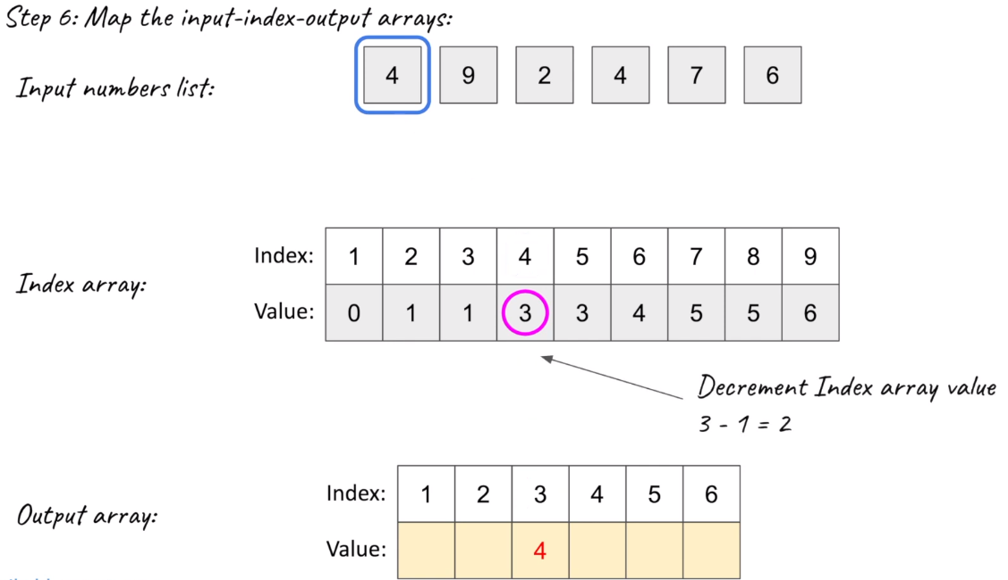
COUNTING SORT

Slide 6
COUNTING SORT

Slide 7
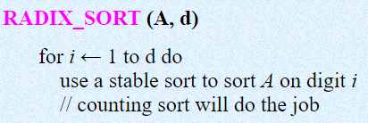
RADIX SORT

Slide 8
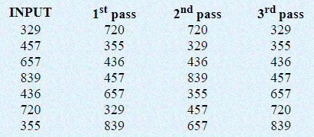
RADIX SORT

Slide 9

RADIX SORT

Slide 10
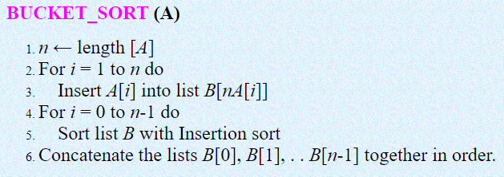
BUCKET SORT

Slide 11
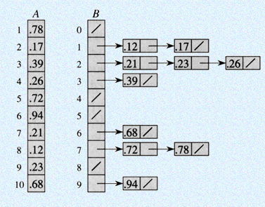
BUCKET SORT

